Slide 1

COMPARATIVE AND PREDICTIVE ANALYSIS OF CRIME IN FIRST WORLD AND THIRD WORLD COUNTRIES (INDIA vs. USA)
GUIDE: Prof CHEMMALAR SELVI
TEAM MEMBERS:
1) 17bcs0003- PREETI RACHEL
2) 17bcs0074- KAMESHWARAN
3)17bcs0123-DINESH

Slide 2

PROBLEM STATEMENT
We need to efficiently analyse data to predict the future trends, patterns and crime rates in the country using data analysis tools. This should help us understand the impact of crimes against women in India vs. a developed country such as USA.

Slide 3
AIM AND OBJECTIVE:
WE AIM TO USE DATA ANALYTICS TOOLS TO UNDERSTAND THE STATISTICS BEHIND THE ALARMING STATE OF CRIMES AGAINST WOMEN IN OUR COUNTRY AND WE AIM TO USE PREDICTIVE TOOLS TO PREDICT THE FUTURE CRIME RATES AGAINST WOMEN IN OUR COUNTRY.

Slide 4
ABSTRACT
According to the National Crime Records Bureau of India, a crime against women is committed every 3 minutes, and the rate of crime showed an increase of approximately 50% from the years 2011- 2015 ( in four years). However, data studies show that crime against women per capita in India is low compared to other countries. This new found information helps us understand that maybe the increased rate of crime in India might be directly related to population growth India has experienced in the past decade. This poses the question, what will be the state of our country in future years?

Slide 5
REQUIREMENTS
SOFTWARE REQUIREMENTS
HARDWARE REQUIREMENTS
ANACONDA PLATFORM
PYTHON3
JUPYTER NOTEBOOK
CRIME ANALYTICS
Any recent system with minimum 4GB RAM will be sufficient for such analysis..

Slide 6
01
INTRODUCTION
PREDICTIVE DATA ANALYTICS ON CRIME AGAINST WOMEN IN INDIA
02
LITERATURE REVIEW
REFERENCES AND INFORMATION ACQUIRED CITED
03
METHODOLOGY
THE STEPS WE HAVE TAKEN TO FIND A SOLUTION
04
ARCHITECTURE
THE DATAFLOW AND UML DIAGRAMS ASSOCIATED WITH THE PROJECT
05
IMPLEMENTATION
PROJECT WORK
06
CONCLUSION
WHAT DO WE UNDERSTAND?

Slide 7
INTRODUCTION
Predictive analysis is concerned with the branch of data mining used to predict future patterns and trends. This modelling technique can be used to aid society. This research aims to foresee the crime patterns against women in India. In recent years, crime against women has skyrocketed and understanding past data can help us come up with insightful patterns that describe the current state of crime and assault in India. The datasets of the past years will be studied using extensive EDA (Exploratory Data Analysis) techniques that will help us understand the problems women and girls of India face. The data will then be cleaned and supervised learning techniques will be executed to predict future trends in crime rates with time.

Slide 8
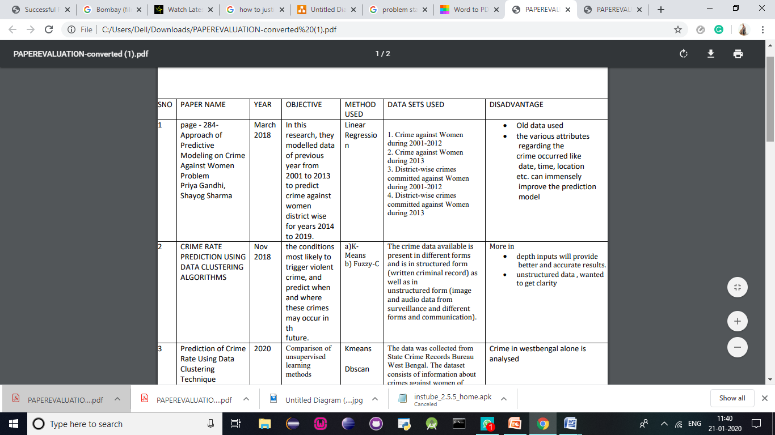
LITERATURE REVIEW

Slide 9
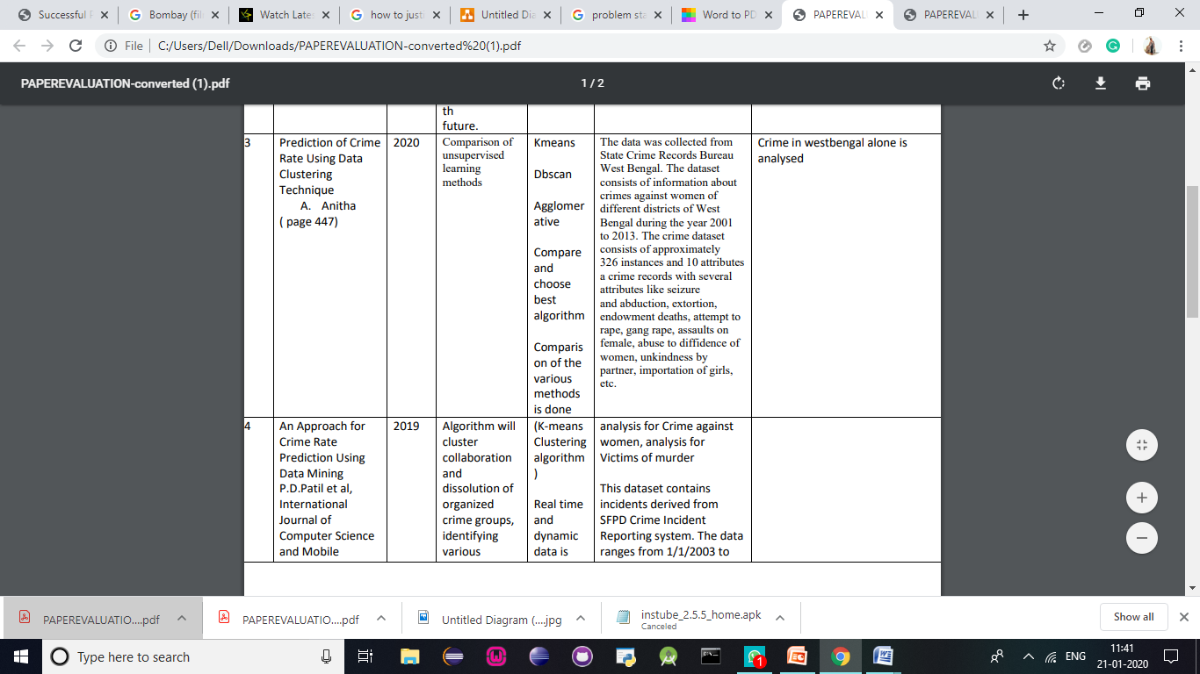
LITERATURE REVIEW

Slide 10
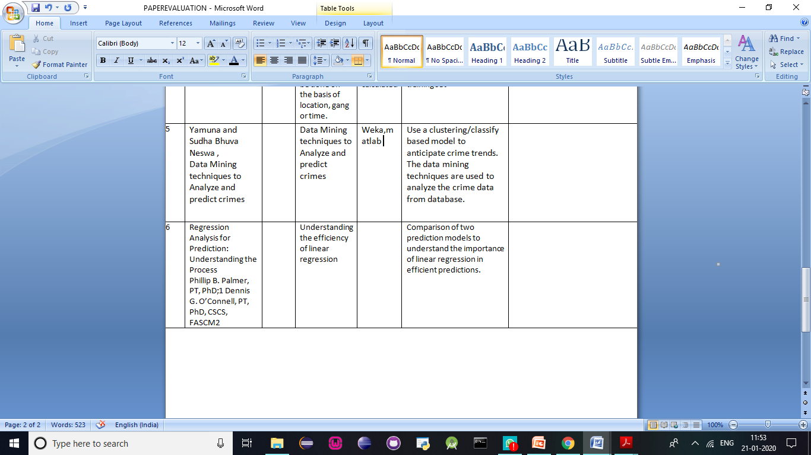
LITERATURE REVIEW

Slide 11
METHODOLOGY
CONCLUSION
ANALYSE
CLEAN
EXPLORE
LINEAR REGRESSION IS USED TO PREDICT THE FUTURE STATE WITH TIME AND PROVIDE USEFUL INSIGHT INTO THE MATTER
WE ARRIVE AT A CONCLUSION BASED ON OUR ANALYTIC METHODS THAT PROVIDES A SOLUTION FOR OUR PROBLEM STATEMENT
DATA
COLLECTION
USE VARIOUS CLEANING METHODS TO MAKE THE DATA MORE CONSISTENT
CONDUCT EDA ( EXPLORATORY DATA ANALYSIS )
COLLECT USEFUL DATA

Slide 12
1. DATA COLLECTION
OPEN SOURCE SITES
GOVT. of India provides us with the required crime data
Our datasets
DATA COLLECTION
Crime against Women during 2001-2012
World crime against women statistics
District-wise crimes committed against Women during 2001-2012
Age and sex wise persons arrested under crime against women during 2012
Persons arrested under crime against Women during 2001-2012.
CHOOSE REQUIRED DATA BASED ON PROBLEM STATEMENT
This data is imported to the notebook

Slide 13
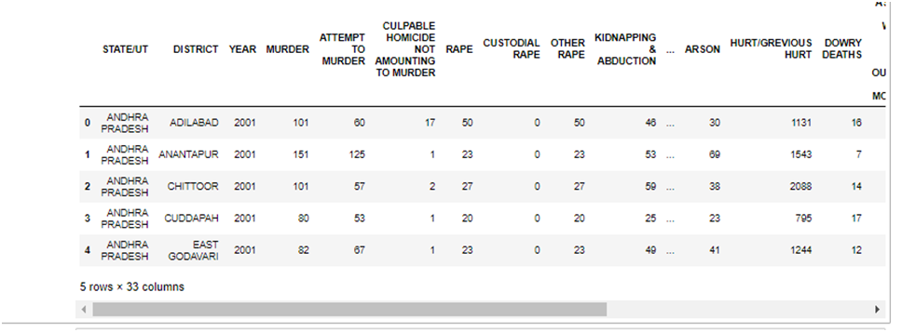
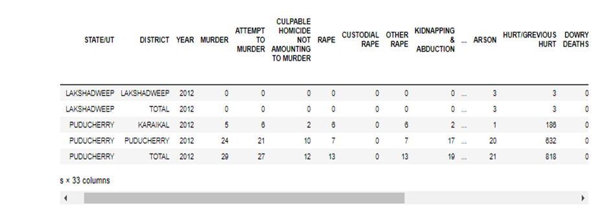
EDA
( Exploratory Data Analysis)

Slide 14
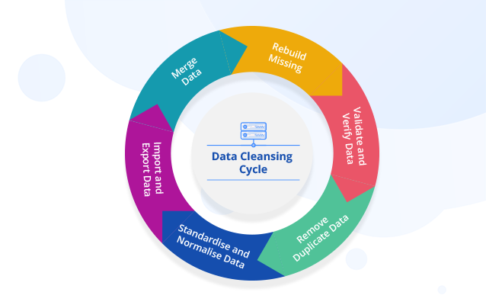
IMPLEMENTATION:
DATA CLEANING: ( Manual and Normalization, clearing of null values)
The datasets will be cleaned of null values and normalized to help us get accurate predictions

Slide 15
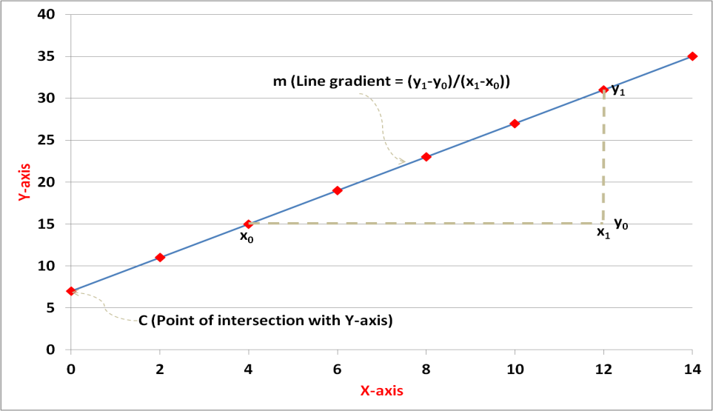
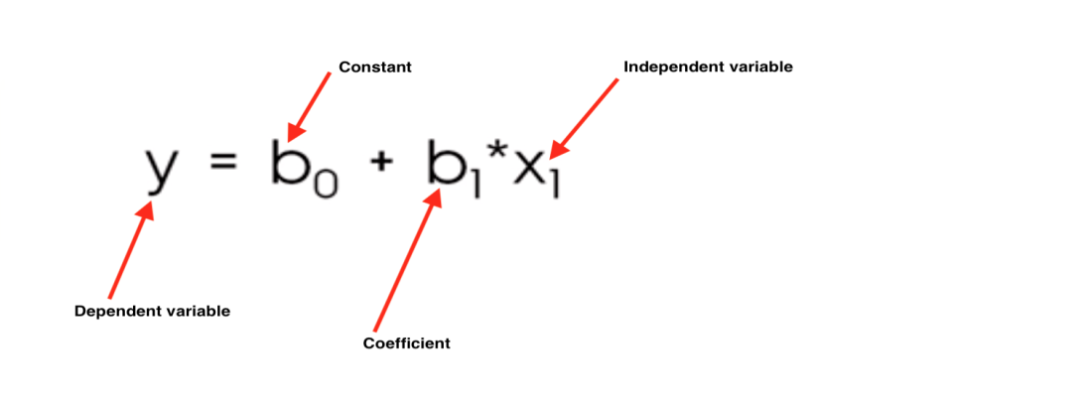
LINEAR REGRESSION:
Linear Regression is a basic and commonly used type of predictive analysis. It’s the most widely used of all statistical techniques. It quantifies the relationship between one or more predictor variables and one outcome variable.
Linear regression models are used to show (or predict) the relationship between two variables or factors. Regression analysis is commonly used to show the correlation between two variables.

Slide 16
ARCHITECTURE AND DESIGN:

Slide 17
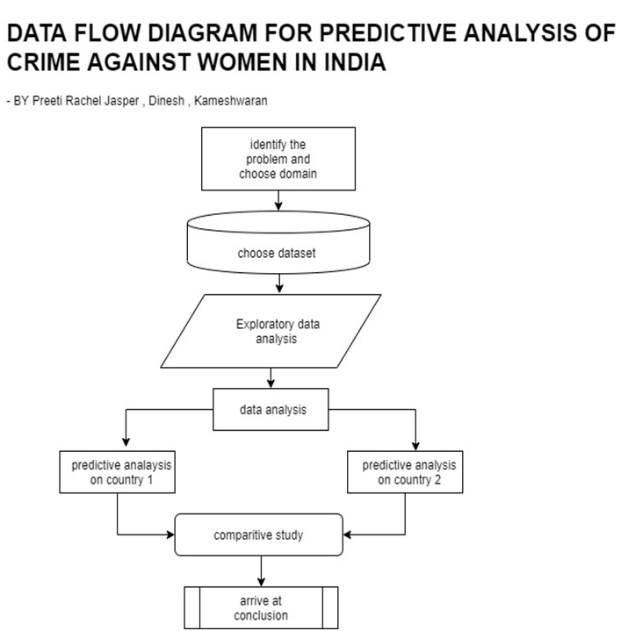
FLOWCHART/ ARCHITECTURE

Slide 18
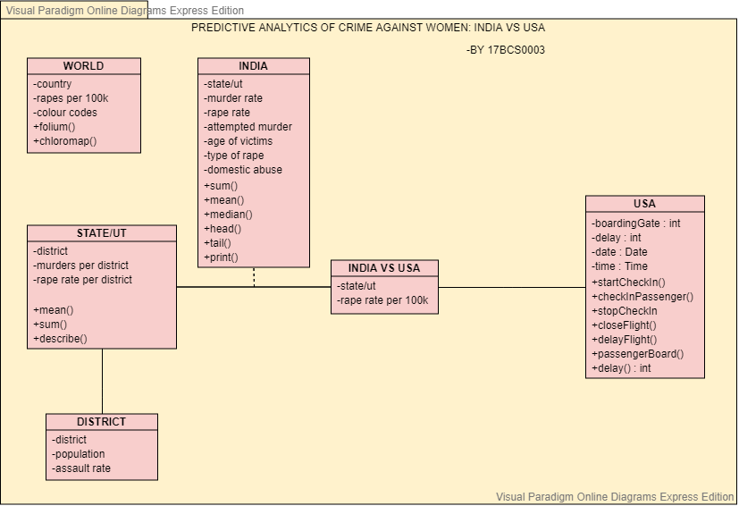
CLASS DIAGRAM

Slide 19
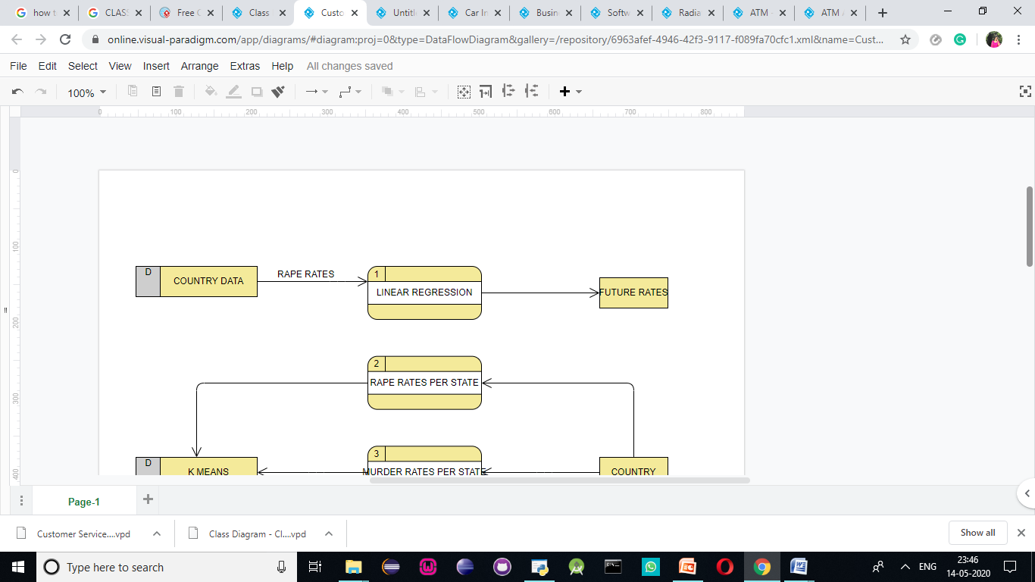
DATA FLOW DIAGRAM

Slide 20
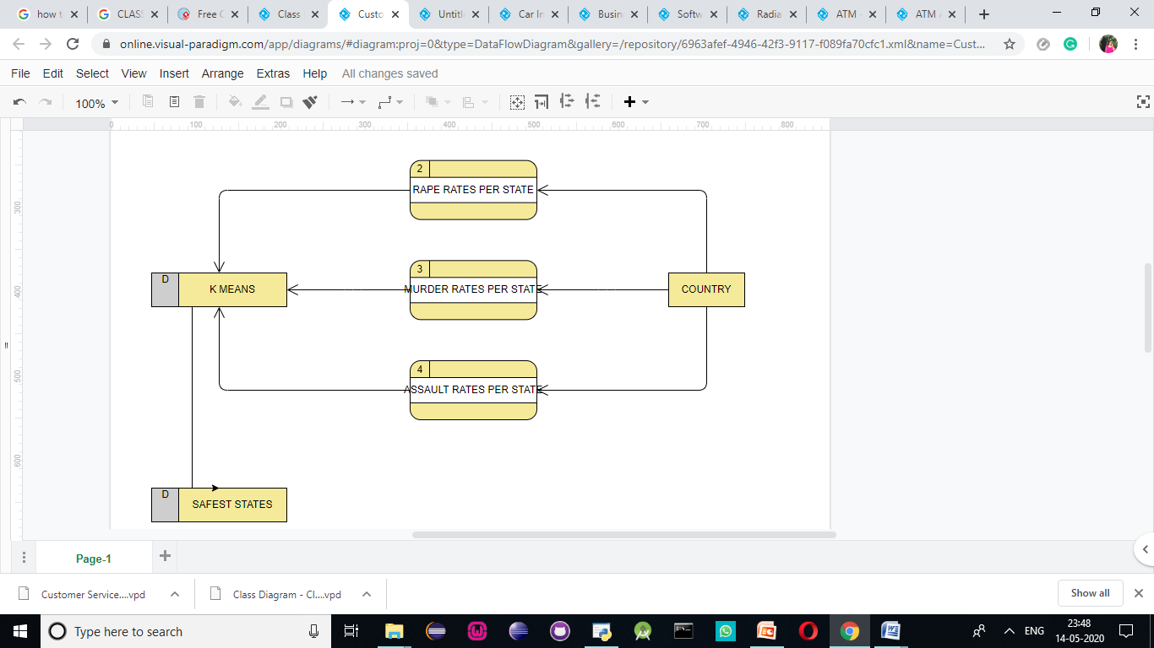
DATA FLOW DIAGRAM

Slide 21
IMPLEMENTATION:

Slide 22
COMPARITIVE AND PREDICTIVE ANALYSIS OF FIRST WORLD AND THIRD WORLD COUNTRIES
( INDIA VS USA ):

Slide 23
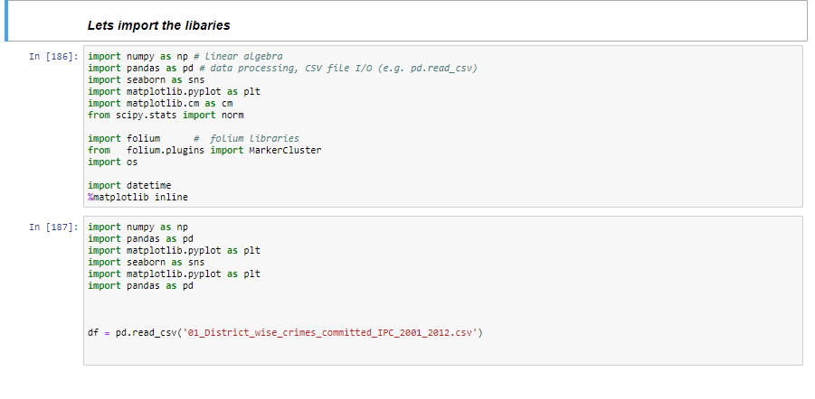

Slide 24
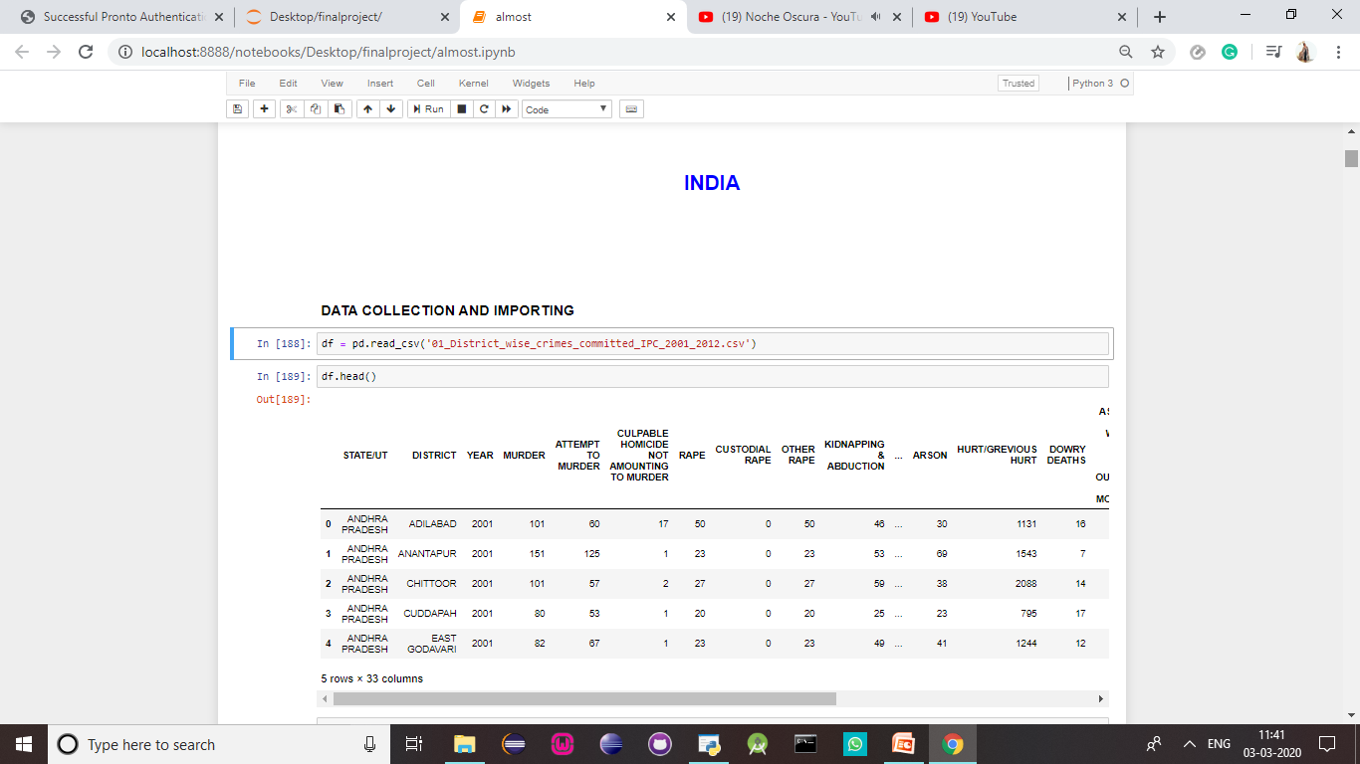

Slide 25
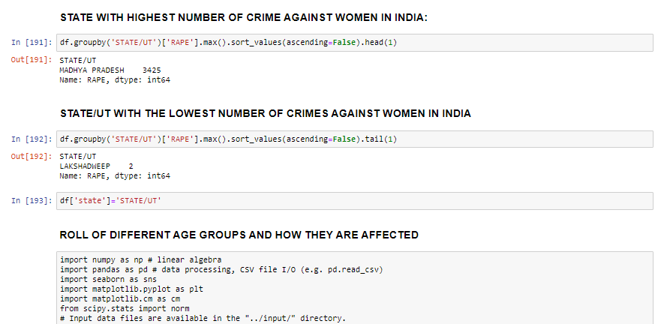

Slide 26
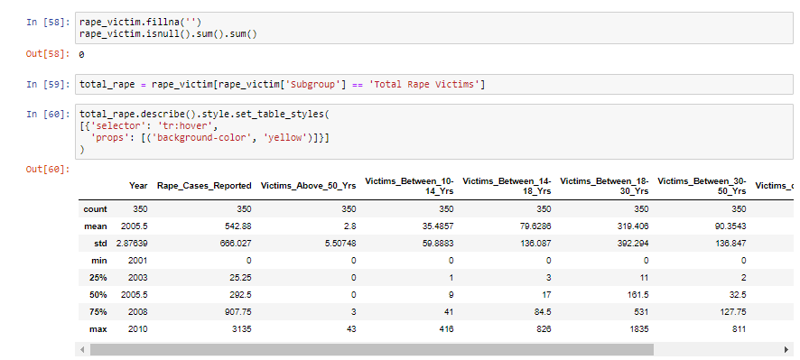
EDA contd.
The age group mostly targeted

Slide 27
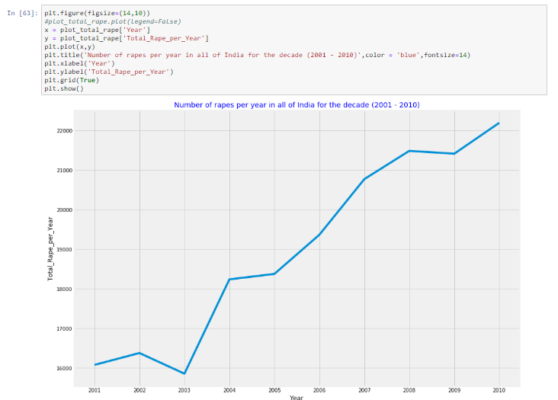
Crime statistics over the decade

Slide 28
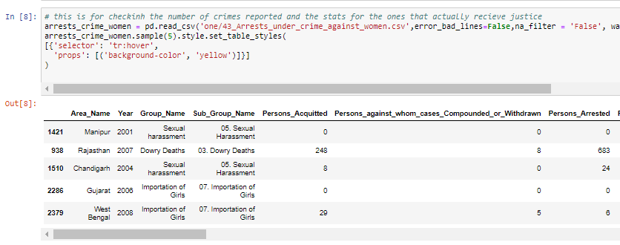
EDA contd.
How many of these receive justice?

Slide 29
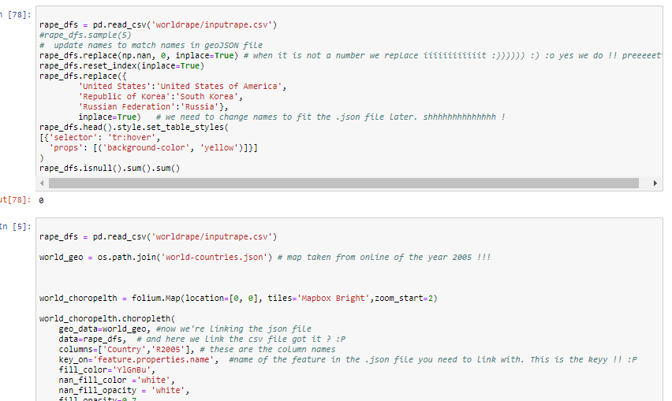
EDA contd.
world statistics :

Slide 30
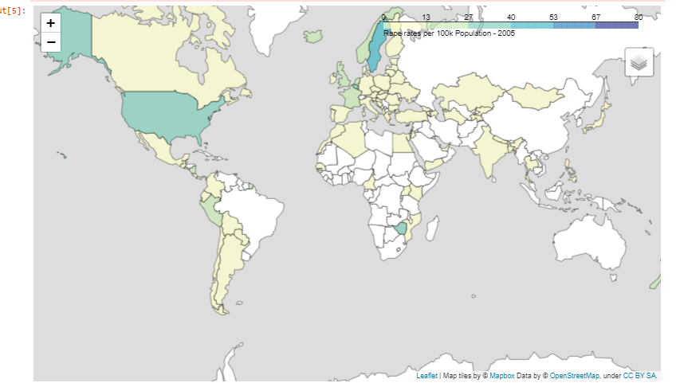
EDA contd.
visualization using folium library

Slide 31
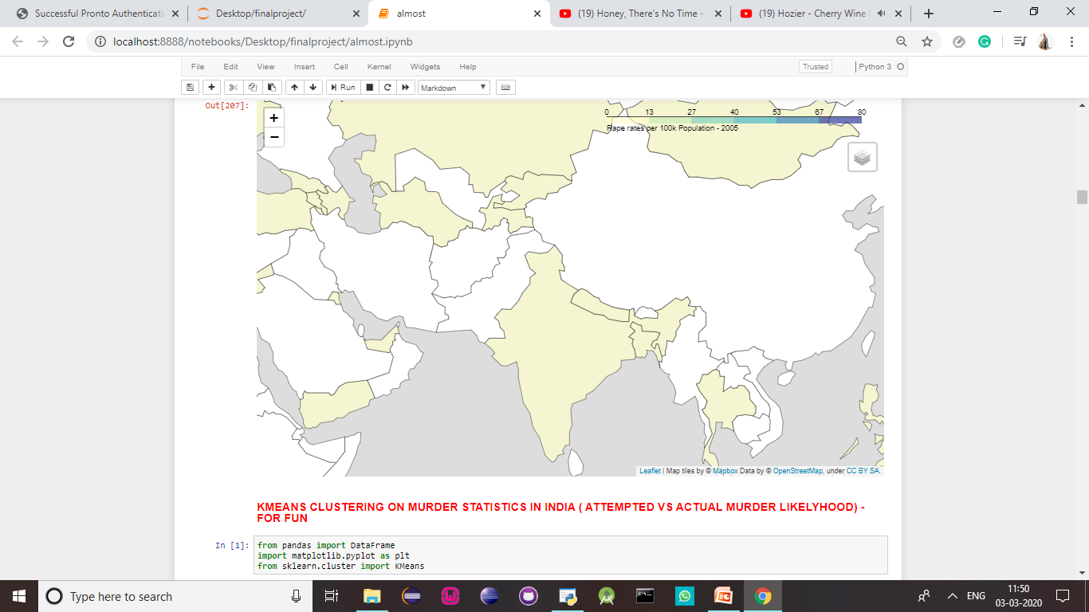
EDA contd.
visualization using folium library

Slide 32
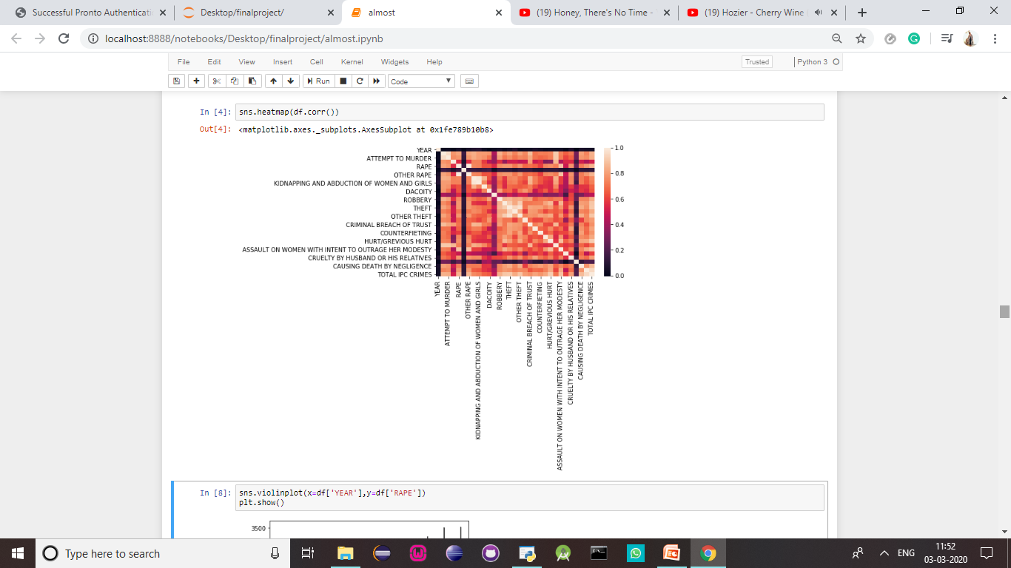

Slide 33
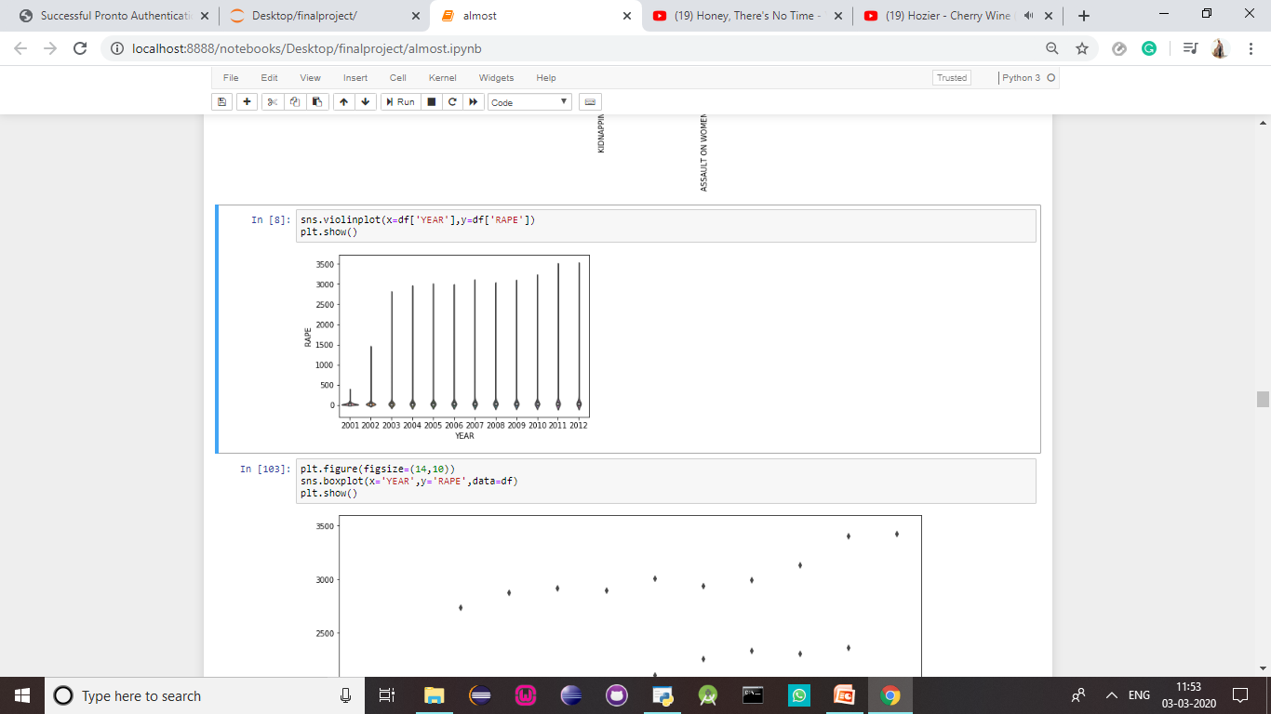

Slide 34
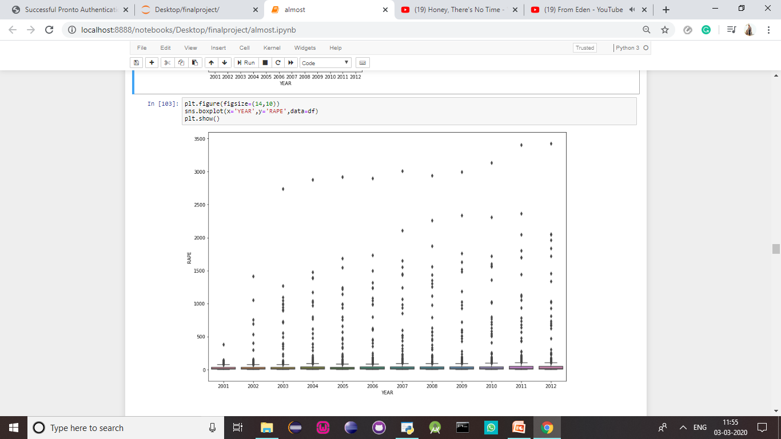

Slide 35
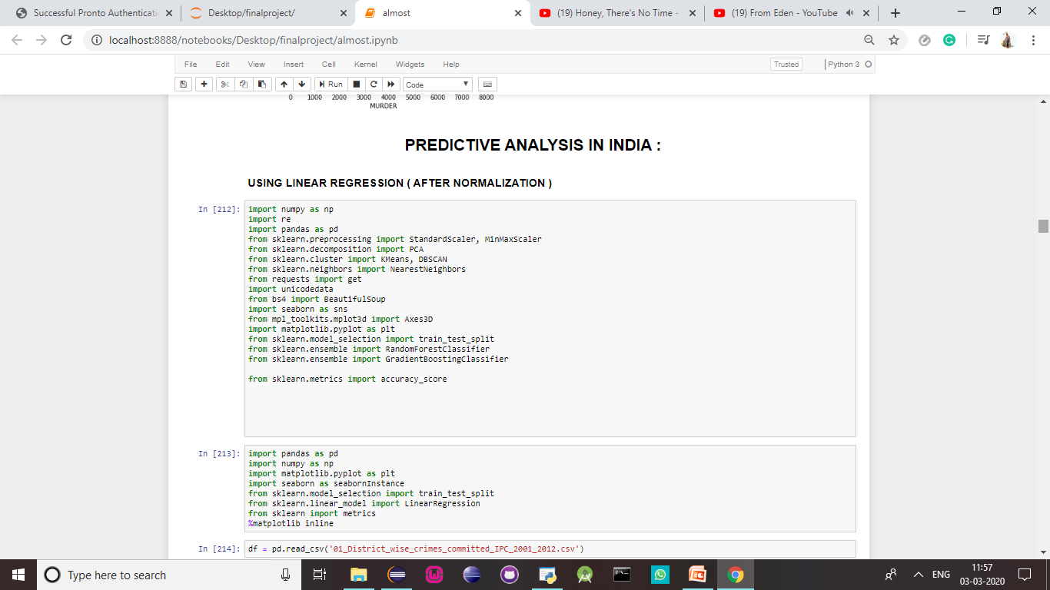

Slide 36
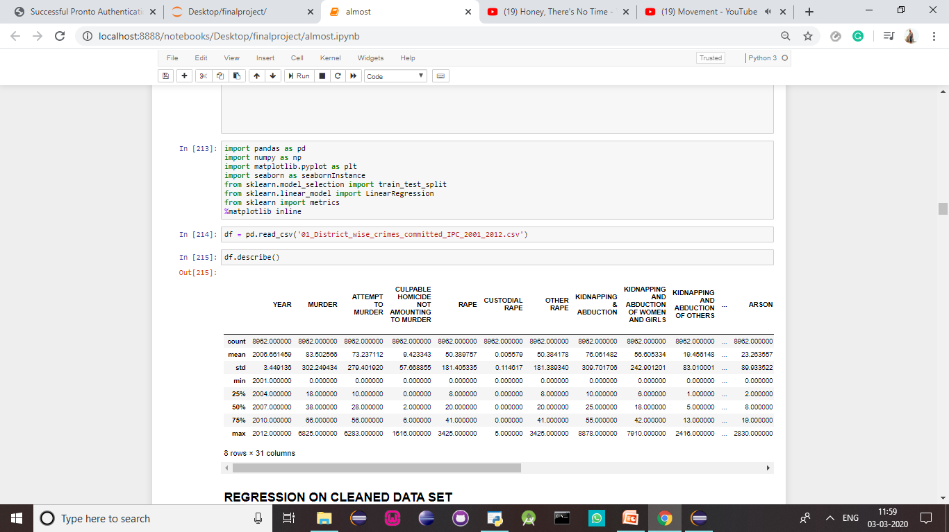

Slide 37
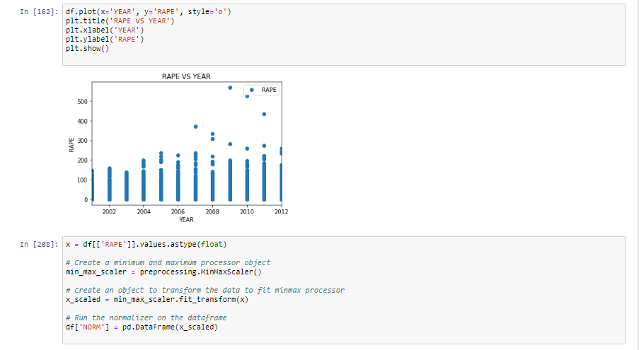

Slide 38
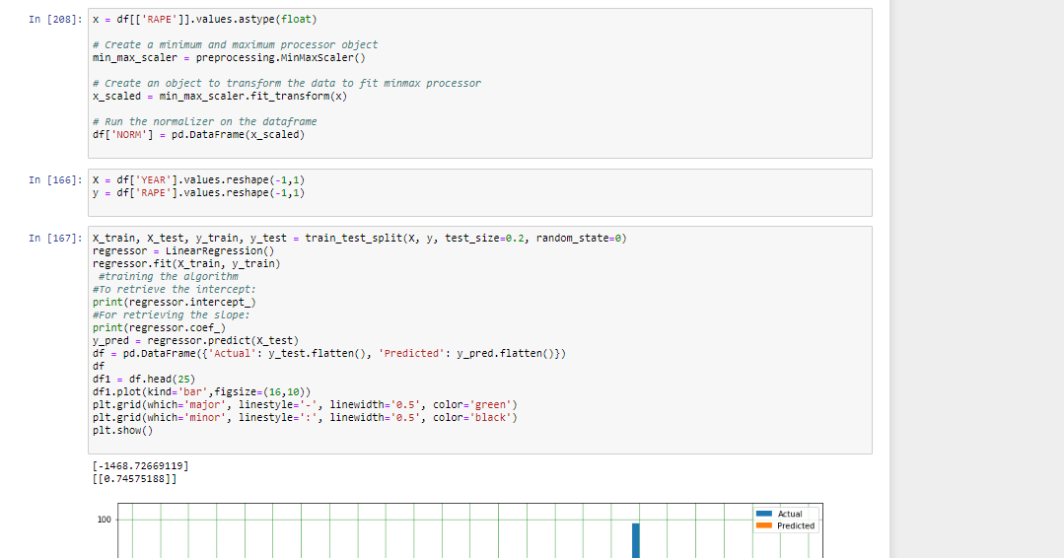

Slide 39
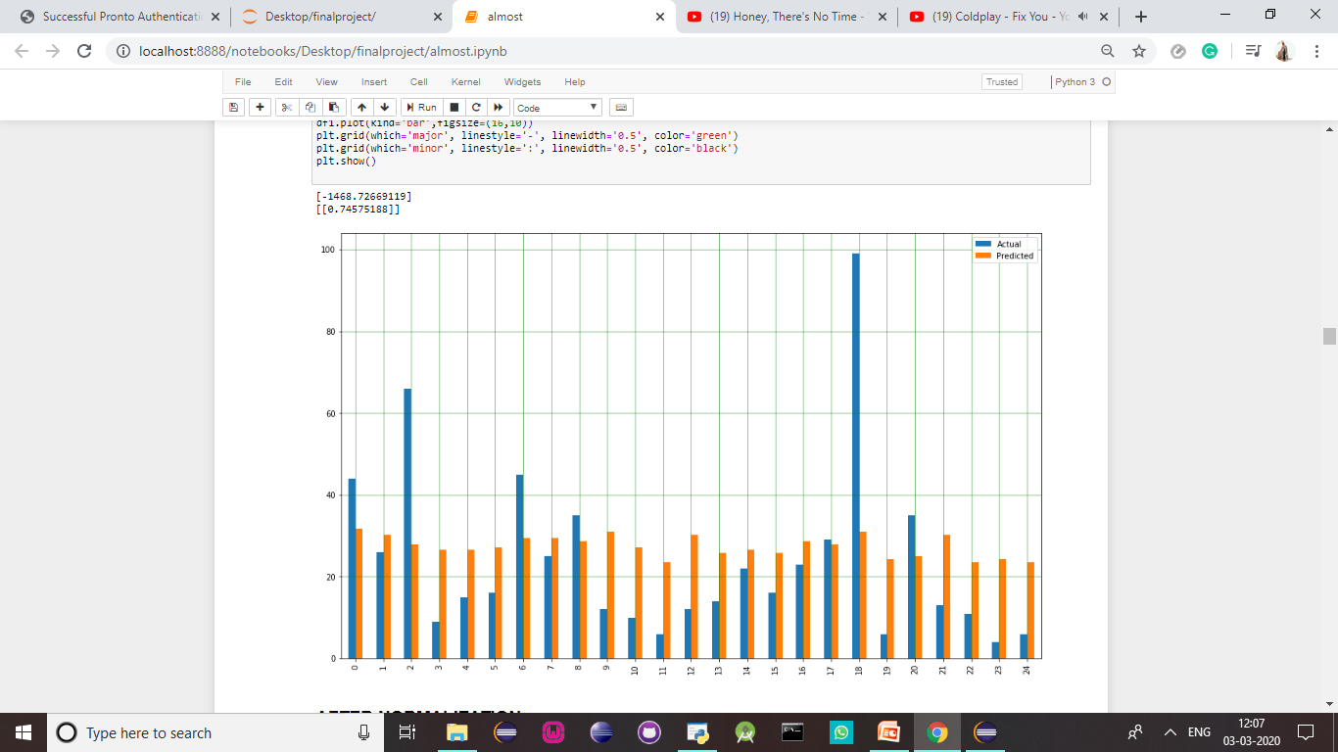

Slide 40
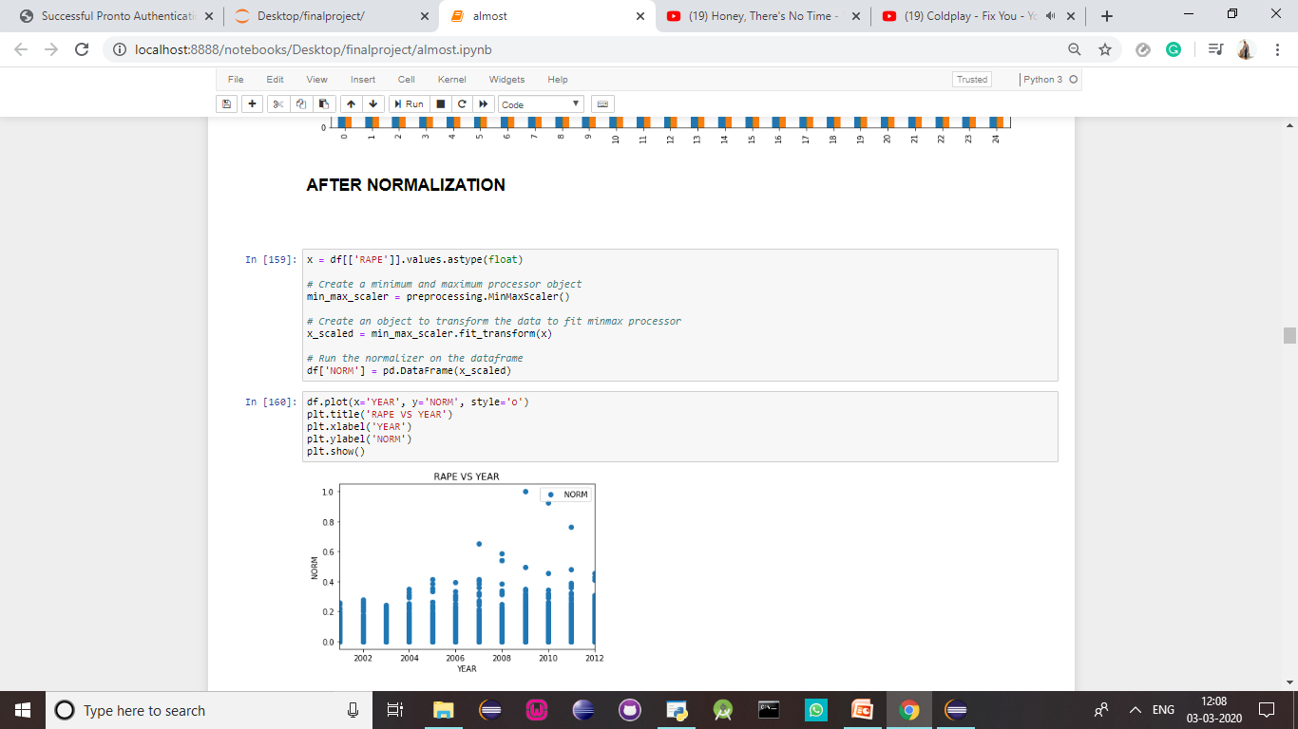

Slide 41
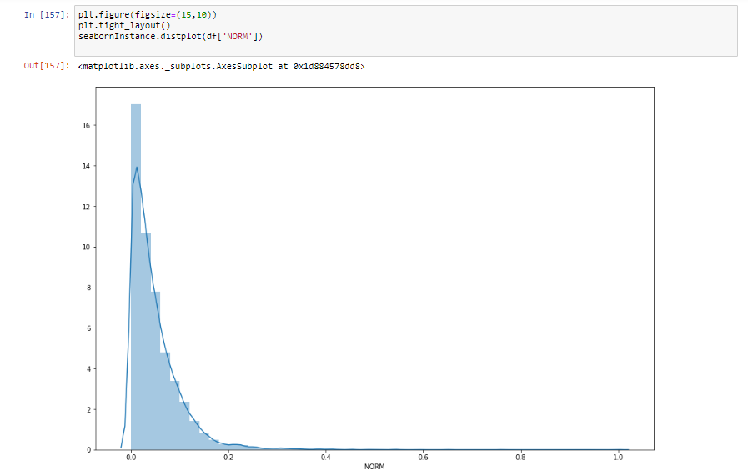

Slide 42
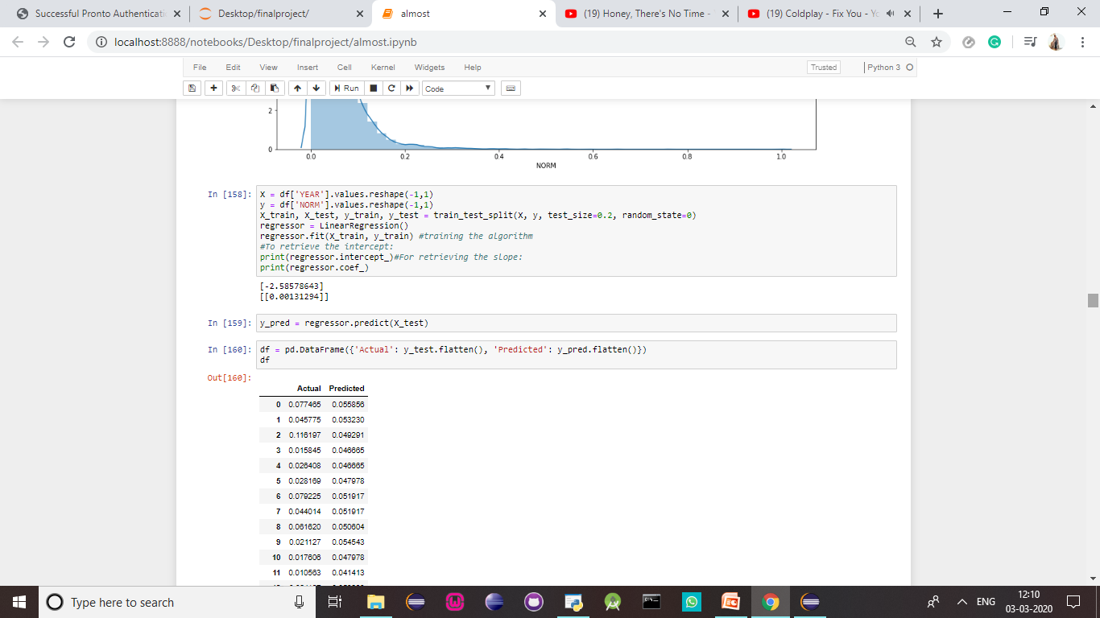

Slide 43
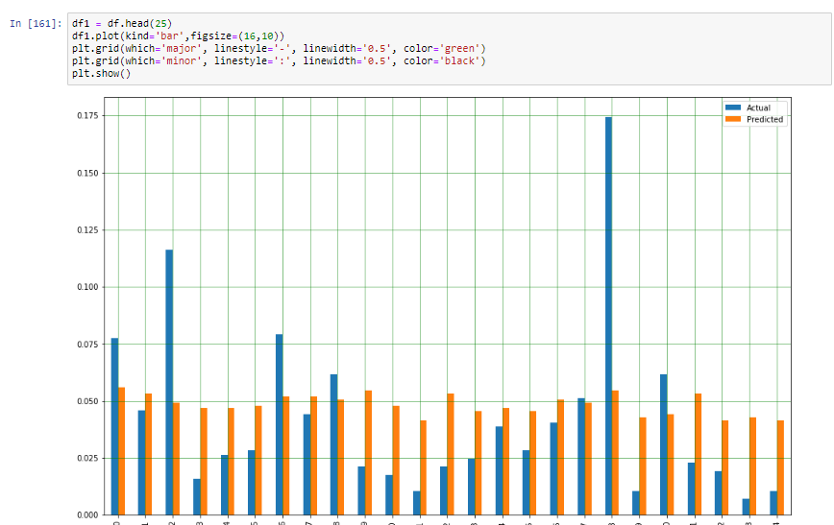

Slide 44
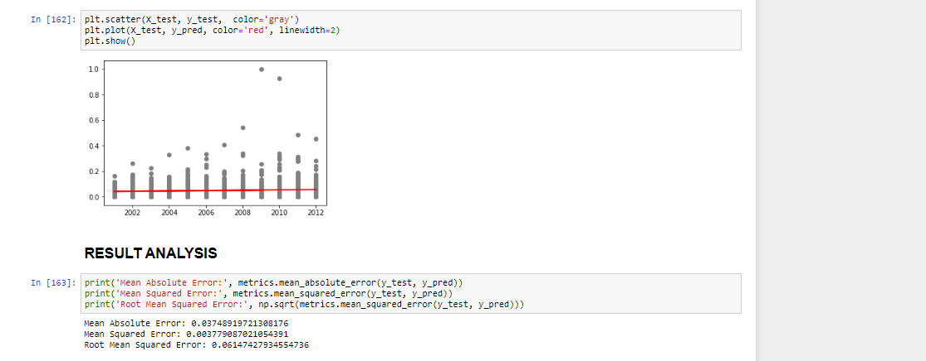
RESULT ANALYSIS:

Slide 45
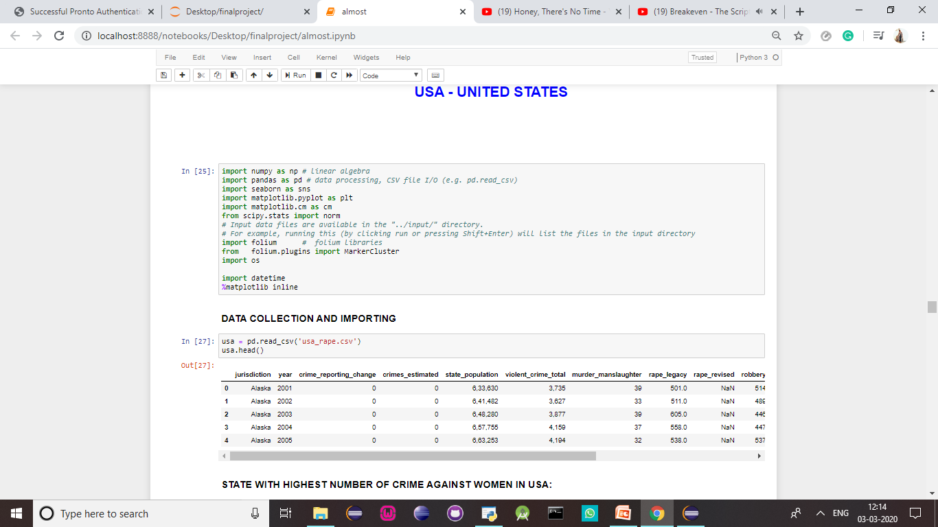

Slide 46
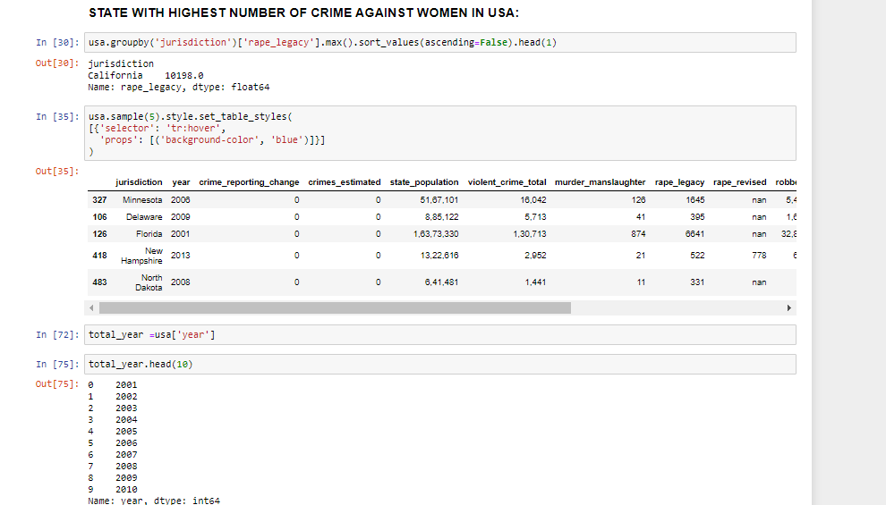

Slide 47
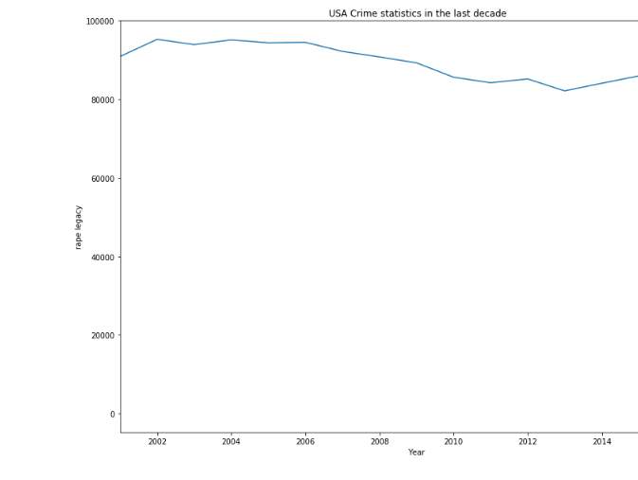

Slide 48
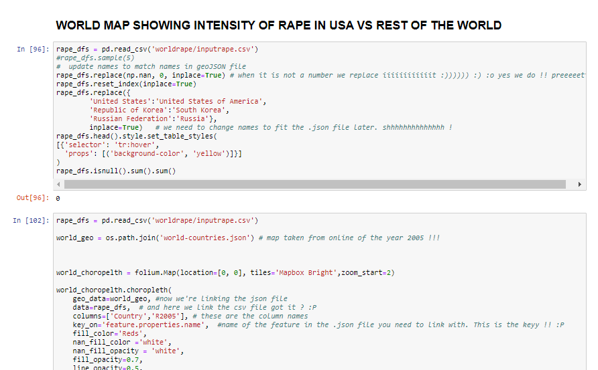

Slide 49
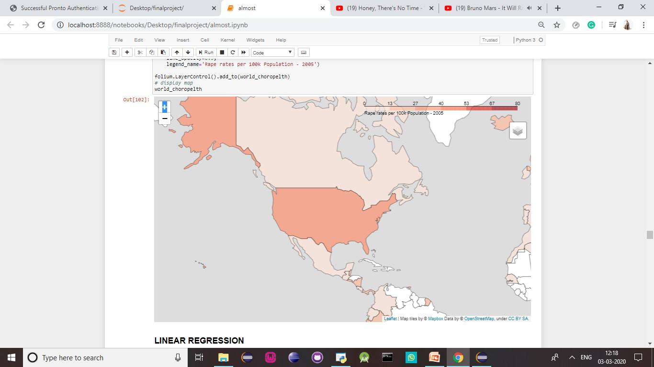

Slide 50
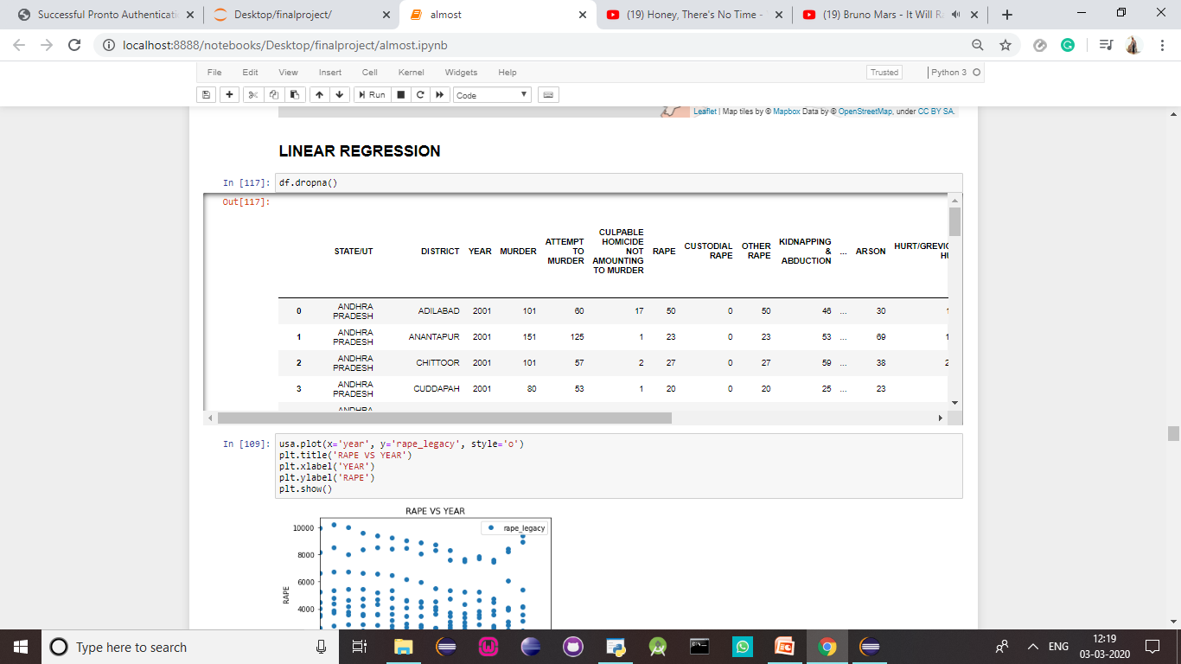

Slide 51
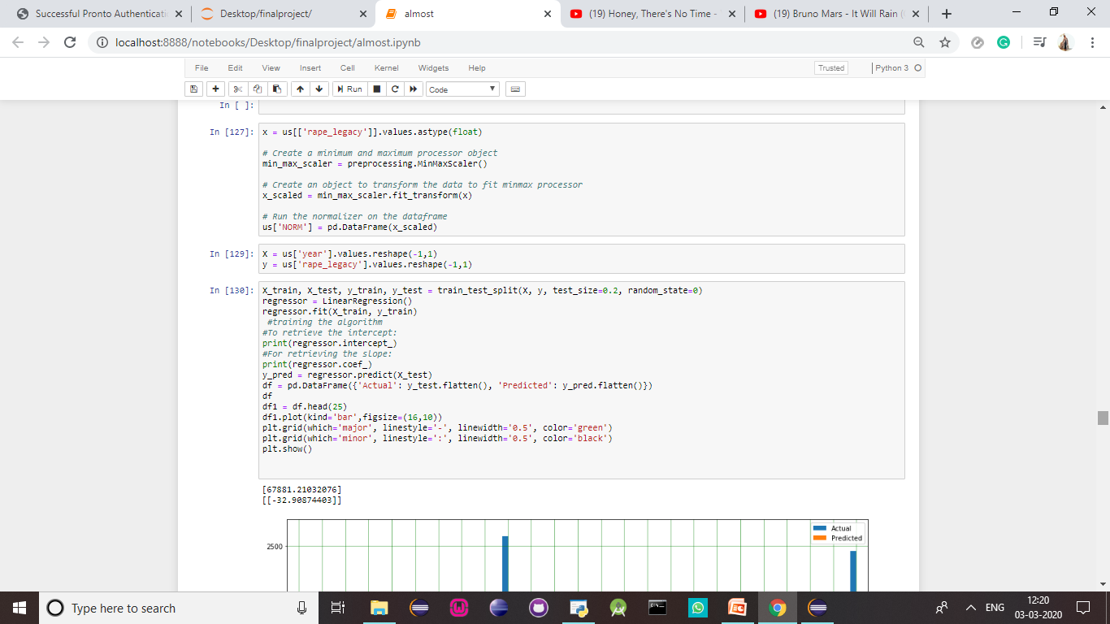

Slide 52
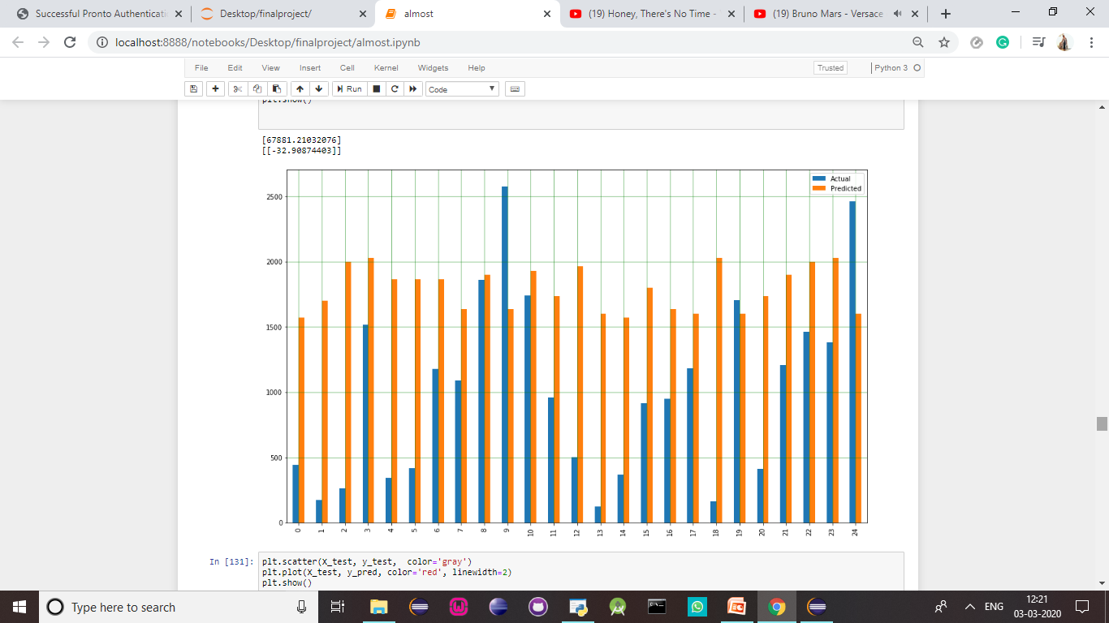

Slide 53
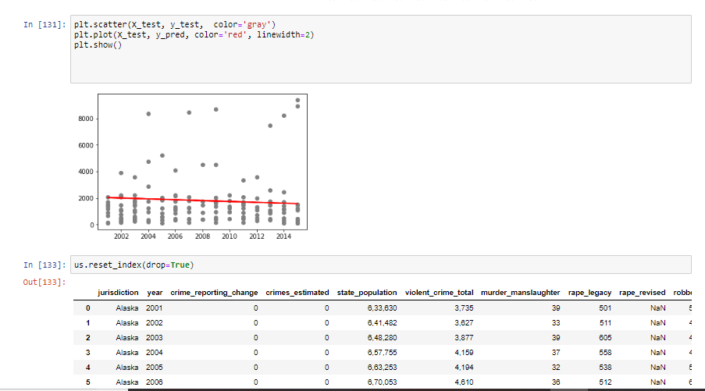

Slide 54
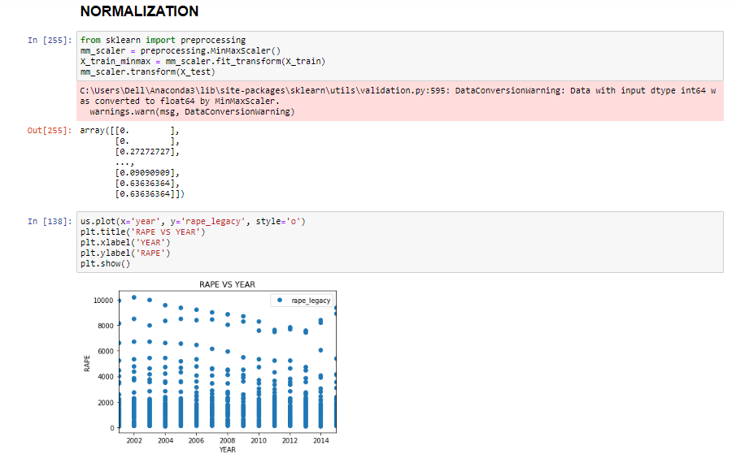

Slide 55
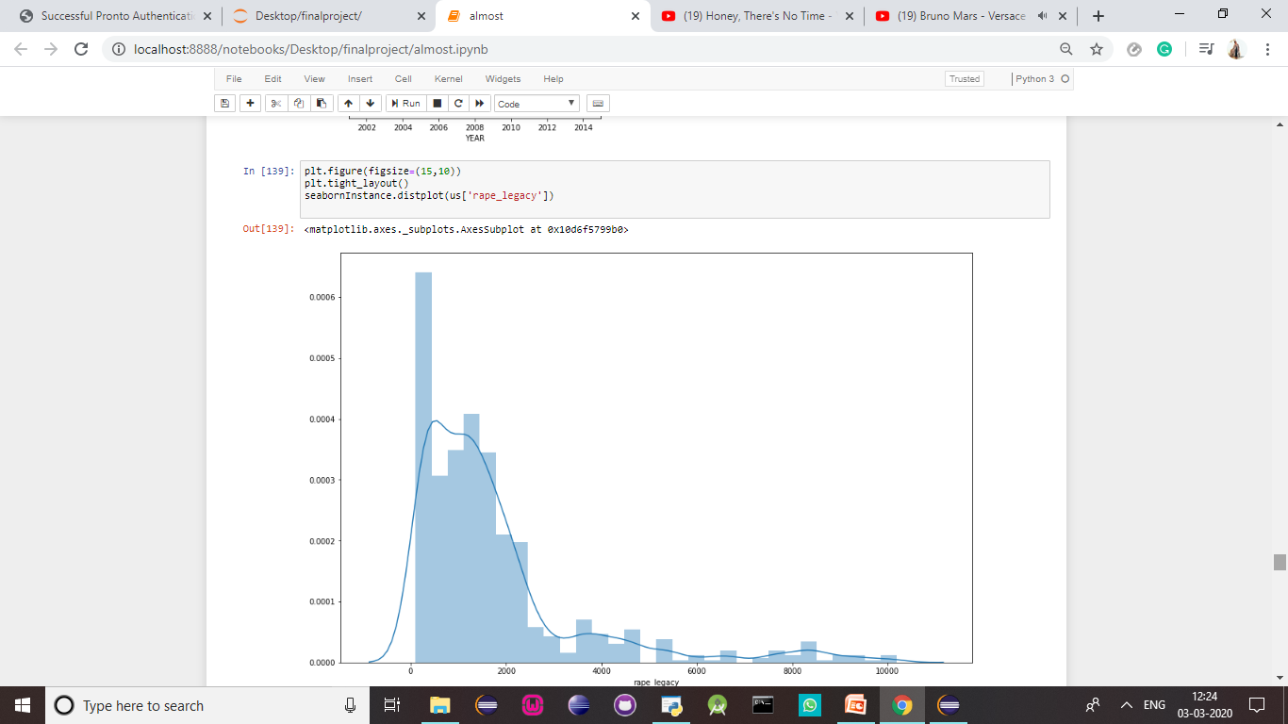

Slide 56
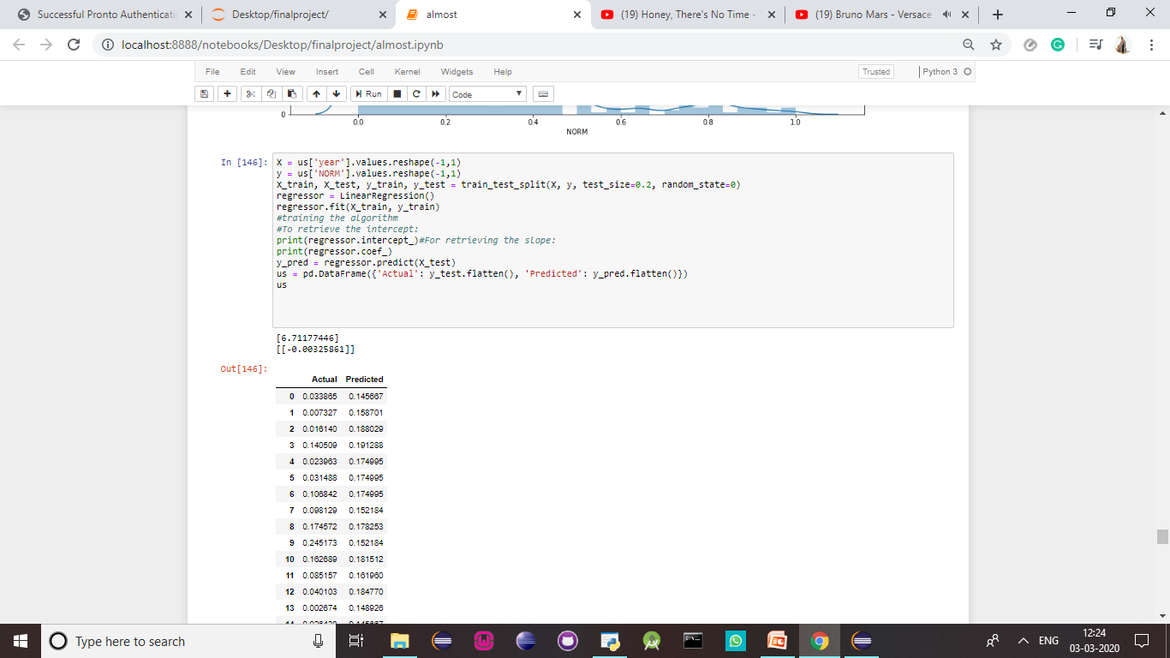

Slide 57
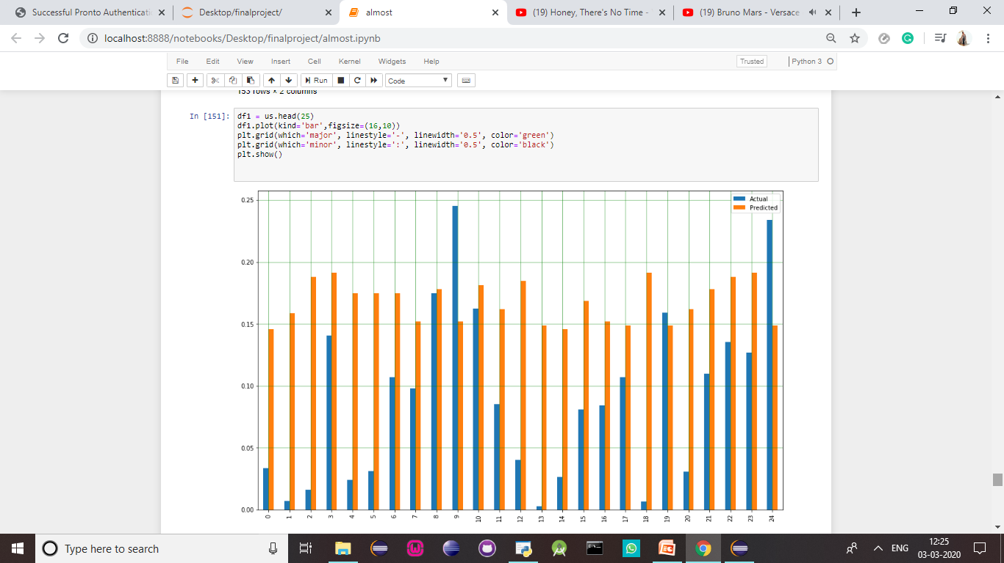

Slide 58
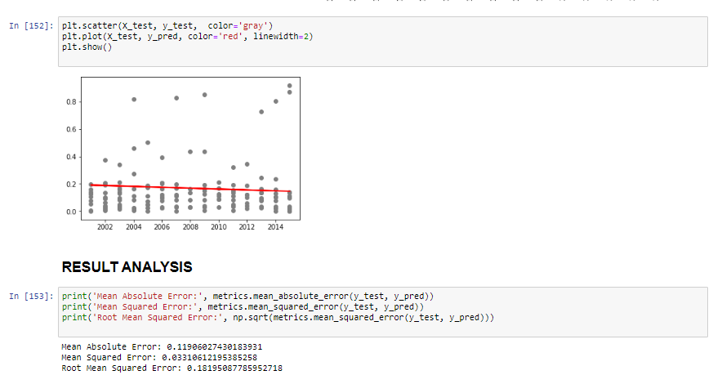

Slide 59
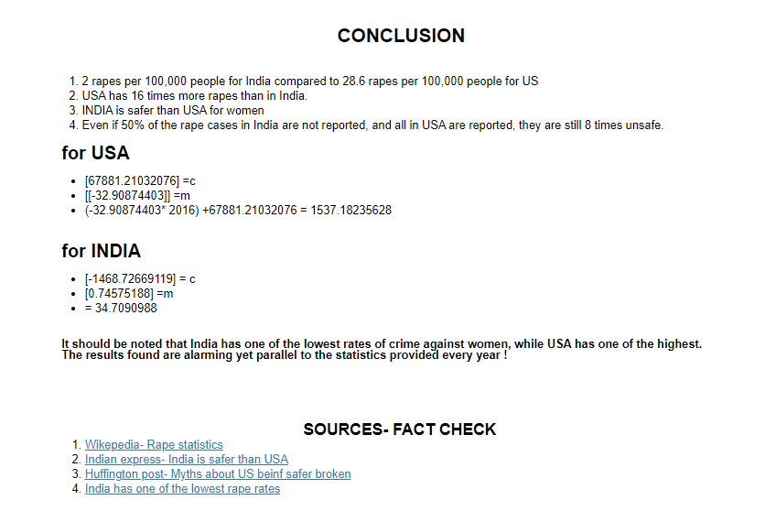

Slide 60
K MEANS

Slide 61
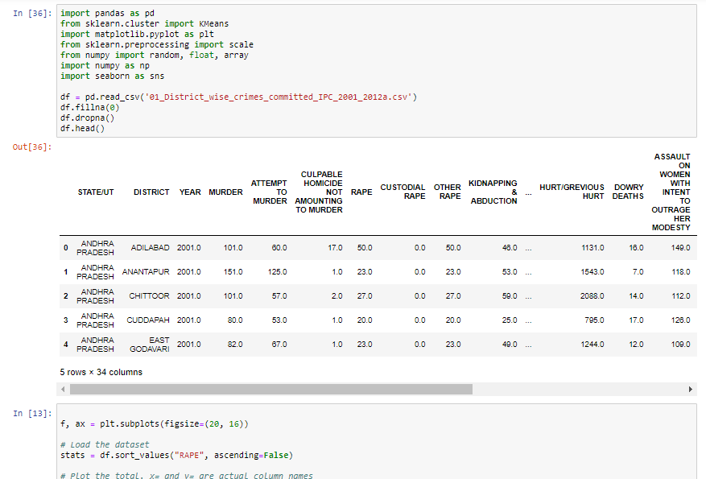

Slide 62


Slide 63


Slide 64


Slide 65


Slide 66


Slide 67


Slide 68


Slide 69


Slide 70


Slide 71


Slide 72


Slide 73


Slide 74


Slide 75


Slide 76


Slide 77


Slide 78


Slide 79
CONCLUSIONS
01
02
03
For USA:
04
Most affected
Age group affected
World statistics per capita
2 rapes per 100,000 people for India compared to 28.6 rapes per 100,000 people for US
Women between the ages of 18-30 are affected most. This hence supports the hypothesis that women who work and are exposed to society more are targeted
(-32.90874403* 2016) +67881.21032076 = 1537.18235628
Per capita rapes are low. Suggests population as a reason for the statistics.

Slide 80
OTHER ALGORITHMS FOR COMPARITIVE ANALYSIS:
KNN :
A k-nearest-neighbor algorithm, often abbreviated k-nn, is an approach to data classification that
estimates how likely a data point is to be a member of one group or the other depending on what group
the data points nearest to it are in.
LOGISTIC REGRESSION
Logistic regression is a statistical model that in its basic form uses a logistic function to model a
binary dependent variable, although many more complex extensions exist. In regression analysis,
logistic regression (or logit regression) is estimating the parameters of a logistic model
(a form of binary regression).

Slide 81

CONTD.

Slide 82
THANK YOU

